Slide 1
HOW TO DEVELOP AND TEACH PRINCIPLES OF GENEROSITY
Stewardship Ministries Department
Inter-American Division
Prepared by J. F. Daniel

Slide 2
INTRODUCTION
Generosity is a guiding principle of life taught in Scripture and is widely accepted in society as a desirable trait. Without it we all would suffer -- givers as well as receivers.

Slide 3
DEFINITION
Generosity is the habit of giving without expecting anything in return. It can involve offering time, assets or talents to aid someone in need.
(http://en.wikipedia.org/wiki/Generosity)

Slide 4
Generosity may also be defined as spending time, money, or labor for others without expecting a reward.

Slide 5
DEVELOPING THE PRINCIPLES--A BIBLICAL PERSPECTIVE
Generosity, and its twin concept of liberality, begins with God, who provided all things to sustain humankind,
even before He
created man
(Genesis 1:1).
Man found every-
thing when he got
here; he brought
nothing with Him.

Slide 6
God is Owner; Man a Steward
God is therefore the owner of all things; man is only a care-taker, or agent, or steward of God’s possessions. (Genesis 1:28, 2;15; Psalm 24:1).

Slide 7
A steward is a servant, but a servant with authority
(Handbook of Seventh-day Adventist Theology, p. 652).

Slide 8
God has given man authority over His property, but God has not abdicate His position as Owner (Psalm 24:1; 50:10-12; 147:8; Haggai 2:8).
Anyone who claims ownership in any way is usurping God’s right.

Slide 9
God’s Generosity in the Gift of Salvation
God’s generosity toward humankind is demonstrated not only in the creation of the earth for man, but also in His gift of salvation.
John 3:16,17

Slide 10
Christ is often described in Scripture as God’s supreme gift to man
(John 3:16. Galatians 1:4; Titus 2:14).
1 John 3:1 – ”How great is the love the Father has lavished on us. . .”

Slide 11
God Gives Constantly and Freely
The Bible makes it clear that we receive all things from God:
1 Chronicles 29:14 – ‘Everything comes from you, and we have given you only what comes from your hand.’
Romans 8:32 -- He graciously gives us all things?

Slide 12
The blessings we receive from God demonstrate His generosity (and liberality). His blessings come in many ways, including material blessings.
His Generosity provides us with the opportunity to demonstrate our generosity.

Slide 13
Generosity: A Trait Accepted by Society
Wikipedia, the online Encyclopedia, makes some interesting observations about generosity as a desired and accepted trait in society:
1. Generosity is a guiding principle for many registered charities, foundations and non-profit organizations (including the Church).

Slide 14
2. In times of natural disaster relief efforts
are frequently provided, voluntarily, by individuals or groups acting unilaterally in making gifts of time, resources, goods, money, etc.

Slide 15
3. Generosity should not be limited to times
of great need such as natural disasters and extreme situations.
Donations are always needed
to support the
work of charitable organizations.

Slide 16
4. Generosity is not solely based on one's economic status, but instead, includes the individual's pure intentions of looking out for society's common good and giving from the heart. . . . passion to help others.

Slide 17
5. Although the term generosity often goes hand-in-hand with charity, many people in the public's eye want recognition for their good deeds.

Slide 18
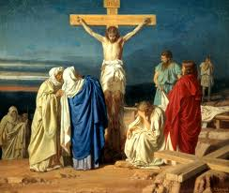
TEACHING CHRISTIAN GENEROSITY
“The cross of Christ appeals to the benevolence of every follower of the blessed Savior.
The principle there
illustrated is to give,
give. This, carried out
in actual benevolence
and good works, is
the true fruit of the
Christian life” (Counsels
on Stewardship, Chapter
One, page 14).

Slide 19
Here are some fundamental principles for teaching Christian Generosity.
1. WE RECEIVE TO GIVE
2 Cor. 9:11
“. . . Enrichment with worldly goods and blessings has but one purpose, that of doing good to others” (Adventist Bible Commentary on 2 Cor. 9:11).

Slide 20
“God imparts His blessing to us, that we may give to others”(Counsels on Stewardship, Chapter 33, page 164).
“Open wide your hand to your brother, to the needy and to the poor” (Deut. 15:11).

Slide 21
2. THE GIVER PROSPERS
Proverbs 11:24, 25 “One man gives freely, yet gains even more; another withholds unduly, but comes to poverty. A generous man will prosper” (NIV).

Slide 22
“A man who distributes in the right spirit gets more good himself than the poor man does who receives the bounty” (Clarke’s Commentary on the Bible, on Prov. 11:25).

Slide 23
“And to all who, in time of trial and want, give sympathy and assistance to others more needy, God has promised great blessing” (Counsels on Stewardship, Chapter 34, page 174).

Slide 24
“The more the giver’s means are used to help others the more he receives” (Adventist Bible Commentary, on Prov. 11:24).

Slide 25
We also gain (1) freedom from enslavement to our possessions, (2) the joy of helping others,, and (3) God’s approval. (Life Application Study Bible, on Prov. 11:24,25).

Slide 26
3. THE RECEIVER BENEFITS
2 Corinthians 9:12. The recipient of generosity benefits and ascribes praise and thanksgiving to God.
[See also Matthew 25:35-36, 40]

Slide 27
4. ACTS OF GENEROSITY ARE MADE TO GOD AND MAN
Matthew 25: 35-36, 40

Slide 28
5. LOVE IS THE MOTIVE
“If I give all I possess to the poor and surrender my
body to the flames,
and have not love,
I gain nothing”
(1 Cor.13:3 NIV).

Slide 29
“A gift to God cannot be measured by its size but by the degree of sacrifice which it represents, and the motive from which it is given” (Mel Rees, God and Man, Inc., p.48.

Slide 30
Motives for any act of kindness are obviously important. They reveal what is in the heart of the giver.
Giving motivated out of a thirst for self-recognition is out of place for the Christian. Matthew 6:3.
True Christian motivation comes from a selfless love whose focus of attention is God and fellow human beings.

Slide 31
6. PERSPECTIVE GAINED
Giving helps us to gain a right perspective on possessions. We realize that they were never really ours to begin with but they were given to us by God to be used to help others.

Slide 32
7.TRANSFORMATION EXPERIENCED
God leaves it to men to exercise the feelings of compassion, tenderness, mercy. And without
occasions afforded to
exercise these, man
would soon become a
Stoic or a brute.
(Adam Clarke’s
Commentary on the
Bible, on Deut. 15:11).

Slide 33
GENEROSITY IS NOT LIMITED TO ECONOMIC POSITION
2 Corinthians 8:2 “Out of the most severe trial, their overflowing joy and their extreme poverty welled up in rich generosity.”
See also Mark 12: 41-44.

Slide 34
Both in temporal and spiritual things, God commonly deals with his people according to the measure by which they deal with their brethren. [See also Luke 6:38; Prov. 19:17; Isaiah 3:11]

Slide 35
CONCLUSION
“The light of the gospel shining from the cross of Christ rebukes selfishness, and encourages liberality and benevolence” (Counsels on Stewardship, Chapter 1, page 14).

Slide 36
The Apostle Paul provides this summary: “And I am praying that you will put into action the generosity that comes from your faith as you understand and experience all the good things we have in Christ.” Philemon 1:6 (New Living Translation).

Slide 37
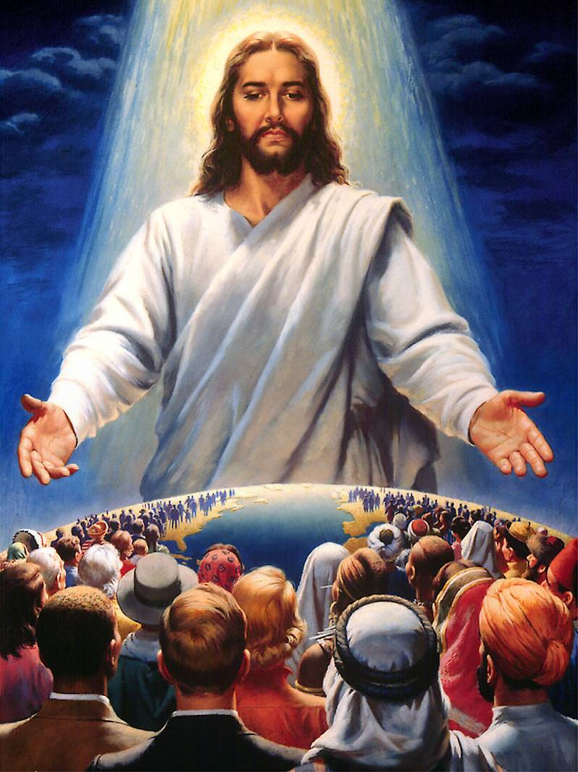
And a reward awaits you, when Jesus comes and declares:
“Well done, good and faithful servant! You have been
faithful with a few
things; I will put
you in charge of
many things. Come
and share your
master's happiness!”
(Matthew 25:21 NIV).

Slide 38
—END—

Slide 39
SEMINAR ACTIVITY [3 Minutes]
Each of you, participants, will now think about (1) what you would consider to be the three most valuable points of this presentation, and (2) what one idea/concept you wish was included.
Share your thoughts with one person seated near you.

