Slide 1
HOW TO CONDUCT
PERSONAL EVANGELISM
WITH LITERATURE

Slide 2
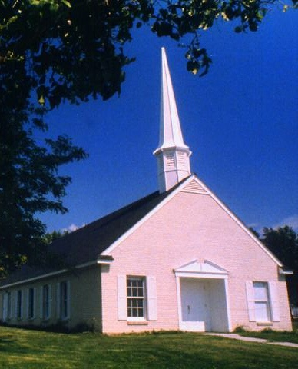
How to conduct personal evangelism with literature
The Seventh-day Adventist local churches on a whole has a great potential for evangelism through the circulation of literature

Slide 3
You could enrich your missionary program by means of an impact evangelistic work through Adventist literature

Slide 4
THE MISSION OF PUBLICATIONS
NUTRI-
TION
(TO FEED)
EVAN-
GELISM
The Mission of publications is doubled:
To use the material for evangelism and for personal nurture of the knowledge of the church members

Slide 5
THE MISSION OF PUBLICATIONS
NUTRI-
TION
(TO FEED)
EVAN-
GELISM
Every member should receive sufficient material to share the gospel and also to feed on them in order to strenghten their spiritual life

Slide 6
HOW TO CONDUCT
PERSONAL EVANGELISM
WITH LITERATURE

Slide 7
By getting
Every member
Of the local
Church
involved

Slide 8
A. THE DIVINE INSTRUCTION FOR THE LOCAL CHURCH
Publishings at the beginning of the Adventist church
In the first phase of the church development, publishings had a very important funtion in the local church. It was one of the most effective instruments in the evangelistic work in order for the church to grow.
At the begining of 1860, the “Leaflet Society and Missionary Work” was established with the purpose of planning and coordinating in a systematic way, the distribution of the printed pages with evangelism in mind.

Slide 9
A. LA INSTRUCCIÓN DIVINA PARA LA IGLESIA LOCAL
Later on the church organized the Departament of Home and Missions (actually the Departament of Personal Ministries).
The distribution of Adventist literatures by the members was the principal part of the missionary activities, which went along with visiting homes, praying for the sick, community services and others.

Slide 10
That is why the number of literatures given away was always a part of the report during the lay-activities segment in the church service and a quarterly report was sent to the Conference or Mission.
Ellen G. White wrote about this missionary work:
“…I believe that this kind of work which characterize the Leaflet Society and its work and in which the greatest part of the church members could and should participate, should receive our attention and support” (Review and Herald, November 6, 1888, p. 7).

Slide 11
A. THE DIVINE INSTRUCTION FOR THE LOCAL CHURCH
2.- The Divine counsel for the church today
Ellen G. White pointed out that God desires that the entire church be involved in the work of taking the gospel message to every nation, kindred, tongue and people. (Review and Herald, June 17, 1893).
She also said that: “Infidel publications are scattered broadcast throughout the land. Why should not every member of the church be as deeply interested in sending forth publications that will elevate the minds of the people…?” (Christian Service, p. 146).

Slide 12
A. THE DIVINE INSTRUCTION FOR THE LOCAL CHURCH
The servant of God affirmed that the church members should sell or give away literature (Manuscript 126, 1902).
She also said, “to ask every Adventist believer to scatter tracts, leaflets and books containing the message for this time” (Review and Herald, November 5, 1904).
“The churches everywhere should have the most profound interest in doing this missionary work with the printed pages. (4T 383.2)

Slide 13
B. ESTABLISHING THE PUBLISHING MINISTRIES DEPARTMENT IN THE LOCAL CHURCH
The Publishing Ministries Department in the Local Church
- The church Manual points out that the Publishing Ministries Department is organized to coordinte and promote evangelism in the local church through publications.
- Its purpose is to involve all the departaments of the local church in the promotion, sales and distribution of books, magazines and other literature.
- They should work together with the pastor and different church departments to plan systematic ways in which to get the church members involved in missionary work.

Slide 14
B. ESTABLISHING THE PUBLISHING MINISTRIES DEPARTMENT IN THE LOCAL CHURCH
The reason for this work is that:
“There are many places in which the voice of the minister cannot be heard, places which can be reached only by our publications, the books, papers, and tracts filled with the Bible truths that the people need” (Colporteur Evangelism, page 5).

Slide 15
B. ESTABLISHING THE PUBLISHING MINISTRIES DEPARTMENT IN THE LOCAL CHURCH
2. Election of the Publishing Ministries Director
The Publishing Ministries Director is elected by the church to direct the activities of promoting, sales and acquiring of materials for evangelism and also to nurture the members spiritually through our literature.
His functions include the following:

Slide 16
A. Preside the Publishing Ministries Council and is responsible to carry out the decisions of the same.
B. Promote, fill orders and obtain printed materials from the Publishing house through the Personal Ministries secretary.
C. Support the Publishing Ministries Department from the Local Field in recruiting church members as colporteurs .
D. Send report of activities from the Publishing Ministries to the Conference or Mission.
E. Is a member of the local church executive board.

Slide 17
C. APPOINTMENT OF THE PUBLISHING MINISTRIES DEPARTMENT COUNCIL
The Church manual points out that the appointment of the Publishing Ministries Council is done by the local Church Board.
1. Members:
Publishing Ministries Department Director –President
Personal Ministries Director
Personal Ministries Secretary
Youth Department Director
Communications Department Director
Church Elder(s)
Church Pastor
Other members who support the publishing work and canvassing.

Slide 18
C. PUBLISHING MINISTRIES COUNCIL
2. Publishing Ministries Council Assignments
- A. Promo the purchase of publishings and help to recruit consecrated men and women to serve the Lord as colporteurs.
B. Give training seminars on publishing and canvassing in the local church
C. Promote the purchasing and reading the Spirit of Prophecy books and many others, for their personal spiritual growth.
D. Help the departments in selecting and circulating the printed pages, such as books and missionary magazines, also the Spirit of Prophecy books.

Slide 19
D. GETTING THE LOCAL CHURCH INVOLVED IN EVANGELISTIC WORK
* Libraries in the
Local churches
Every local church should have a library for the church with different Spirit of Prophecy books, for the home, health along with other religious books. Then they should establish a program for reading, consulting and lending out books for the growth and spiritual nurturing of the church members, so they could evangelize their neighbours.

Slide 20
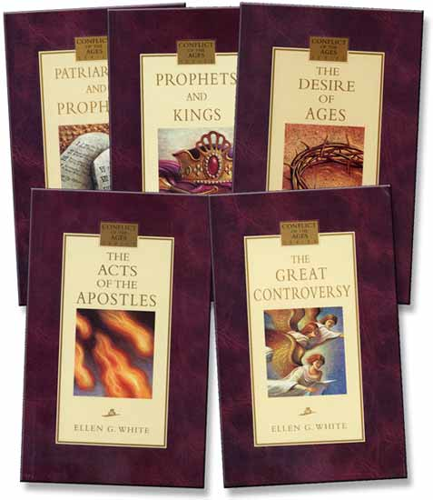
D. GETTING THE MEMBERS INVOLVED IN EVANGELISTIC WORK
* Personal
libraries
The church members should purchase
Sufficient Spirit of Prophecy books, books for
Home and health along with others like magazines
So that they could establish a personal library for the
Strengthening of their knowledge on the church doctrins and also
to evangelize their none adventist friends by sharing the literature with them.

Slide 21
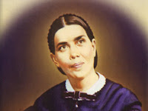
THE DIVINE COUNSEL
The church should organize a plan
for the distribution of literature
and place the Spirit of Prophecy
books and Testimonies in the library
of each family, so that they could
read them easily. (Testimonies 4, p. 383)
The members should lend their neighbours some small books to read and when their interest is awaken, they should lend them bigger books and encourage them to purchase their own. (R&H, November 6, 1888).

Slide 22
E. DEVELOPMENT OF THE PLANS FOR THE CIRCULATION OF LITERATURE
* SETTING UP THE SHOWCASE:
Every local church should function as a Resource Center of printed materials for evangelism and nurturing of the members by setting up showcases.
The Unions, Local Fields and Agencies will present initiatives to set up a showcase together with the local church so that the members and visitors could obtain sufficient materials.
The publishing houses should cooperate with this project in making the materials accessible.

Slide 23
E. DEVELOPMENT OF THE PLANS FOR THE CIRCULATION OF LITERATURE
The Publishing Ministries Council of the local church will be in charge of this work to obtain materials in the Agencies and promote them constantly.
The members should supply their personal libraries by purchasing materials from the showcase of the church.
The materials should be promoted
adequately so that those who visit the
church would want obtain them.

Slide 24
E. DEVELOPMENT OF THE PLANS FOR THE CIRCULATION OF LITERATURE
* EVANGELISTIC INPACT PROJECT (That the World may know)
“Missionary book of the year” –Every year the GC and the Division choose a missionary book of the year to be published in large quantities and distributed by the members in an evangelistic imact program.
Every local church should be involved in obtaining quantities of this missionary book to evangelize their cities or communities.
Every member should purchase several missionary books to be donated for evangelism.

Slide 25
E. DEVELOPMENT OF THE PLANS FOR THE CIRCULATION OF LITERATURE
Every missionary book that is distributed by the church member should carry a stamp with the address of the church.
The church member should place the missionary books in hotels, schools, banks, businesses, hospitals, homes and many other places.
The church member should share them with their neighbours, friends, coworkers and in the schools on a special date to provoke a true Evangelistic Impact by the local church .

Slide 26
E. DEVELOPMENT OF THE PLANS FOR THE CIRCULATION OF LITERATURE
Susbscription of missionary magazines
The Publishing house offers the local church yearly subscriptions of religious missionary magazines and health literatures at a reduced price.
Every member should get at least 2 yearly subscriptions of magazines. One for personal use and the other to give to a friend, a neighbour or a non adventist family member.
Areas where the message have not entered should be identified and every church member should be assigned to evangelize the area.

Slide 27
E. DEVELOPMENT OF THE PLANS FOR THE CIRCULATION OF LITERATURE
* Dedicate a pocket to the Lord
Every Adventist member should always take with them some pocket books whenever they travel or leave their home (market, work, etc.) to give to people and to spread the gospel through the printed pages.

Slide 28
F. GIVING SUPPORT TO THE CANVASSING MINISTRY
The local church can cooperate with the Lord’s work through the Publishing Ministries:
Reccomendation of persons to work in the Canvassing Minisrty
The church board should select consecrated persons, who are faithful and prosperous and encourage them to join the Local Field canvassing ministry and recommend them to the Publishing Director of the Conference or Misison.

Slide 29
F. GIVING SUPPORT TO THE CANVASSING MINISTRY PROGRAM
2. Moral Support for the Colporteurs of your church
The leaders from the local church should give all moral support and facilities to the colporteurs of their church or to those who come and visit. They should pray for them, give recomendations about them and the books they offer to the members.
Colporteurs are self supported workers and they depend totally on their faith in God and on their strength in the work to sustain themselves financially. They need the appreciation, love and moral support of the members.

Slide 30
F. GIVING SUPPORT TO THE CANVASSING MINISTRY PROGRAM
3. Celebrating and Patronizing the meetings for Colporteurs Comradeship
The coplorteurs constantly celebrate comradeship and spiritual strengthening meetings. The local church should give all their support to the colporteurs and their activities. This includes providing the place to hold their meetings, the assistance of the members and where possible the food for those assisting.
The church members are blessed and refreshed when they listen to the experiences that are shared in these meetings.

Slide 31
G. PARTICIPATION IN THE CANVASSING WORK SELLING PRINTED MATERIALS
Our church members could participate in evangelism by scattering our Adventist literatures through sales and subscriptions.
1. Special Colporteurs
a. Colporteurs for “Holy Week” – workers and church members who canvass during the “Holy Week”, together with the Colporteur’s Emphasis Week”, designated by the Division.

Slide 32
G. PARTICIPATION IN THE CANVASSING WORK SELLING PRINTED MATERIALS
b. Colporteurs for festive days –Members who canvass during the festive days.
c. Children colporteurs – The children of the church could be organized into testifiction teams:
1.- The Aventurers and Pathfinders could be instructed to sell literature with a missionary purpose and obtain resources, along with their “AY Honors”.
2.- Students of our schools could be organized and instructed to sell literature during their vacation with a missionary purpose in mind and also to finance projects for the church.

Slide 33
G. PARTICIPATION IN THE CANVASSING WORK SELLING PRINTED MATERIALS
3. Student canvassing helps the student financially to obtain a christian education.
Provides a good financial income for the school which is paid in cash by the publishing houses and adventist bookstores, in favor of the student colporteur.
Canvassing enables the student to have excellent vision, training and experience in personal evangelism.

Slide 34
G. PARTICIPATATION IN THE CANVASSING WORK SELLING PRINTED MATERIALS
d. Participation in the “Magazine Campaign” – Every year the Union assignes a month for the “Magazine Campaign”, where the members participate by selling adventists magazines, such as “Priorities” and “Enfoque”, health magazines and others.

Slide 35
G. PARTICIPATION IN THE CANVASSING WORK SELLING PRINTED MATERIALS
e. Participation in the Spirit of Prophecy Books Annual Campaign – Once every year, the Division or Union could assign a week where the church members are encouraged to go out and sell the Spirit of Prophecy Books to their none adventist friends and neighbours. These books could be:
The Great Controversy series
A Series for Family Growth (an abbreviated edition from The Adventist Home, Child Guidance, Education, Ministry of Healing, Practical leccions from the great teacher)

Slide 36
G. PARTICIPATATION IN THE CANVASSING WORK SELLING PRINTED MATERIALS
2. Colporteurs from Global Mission
The large churches in coordination with the Union, Conference and Mission, could send and support missionary colporteur teams to work in territories where the message has not yet entered.
a. The teams of missionary colporteurs are sent to these territories for a specific period of time until there is an awakening of interest.
b. This program could be financed through Global Mission funds. You could also make arrangements for financial subsidies between the Union, Conference or Mission and the local church who patronizes the team of colporteurs for Global Mission.

Slide 37
G. PARTICIPATATION IN THE CANVASSING WORK SELLING PRINTED MATERIALS
4. Regular Part time Colporteurs
a. We encourage the members to participate in part time canvassing under the direction of the (coordinator) of Publishing Ministries and the Publishing Ministries Council of the local church. The church needs more part time colporteurs.
b. The Publishing departments of the Unions and Conferences/Missions should be in charge of providing the necessary instructions for these members who work as part time colporteurs.

Slide 38
G. PARTICIPATATION IN THE CANVASSING WORK SELLING PRINTED MATERIALS
c. Through house to house visitation, the teams could carry out the following missionary activities or activities of testification:
Sell small religious books, books on health and magazines
Give out free booklets
Obtain inscriptions to the Voice of Prophecy
Invite people to assist to the different church services
Pray with the people
Develop their interest to receive Bible study

Slide 39
G. PARTICIPATATION IN THE CANVASSING WORK SELLING PRINTED MATERIALS
5. Full time Colporteurs (their career)
The church opens its arms to welcome any member who wants to dedicate their life, time and talents to canvassing as a full time job. We encourage the local church to recommend to the Publishing board of the Conference or Mission, the names of persons who are capable for canvssing.

Slide 40
G. PARTICIPATATION IN THE CANVASSING WORK SELLING PRINTED MATERIALS
The full time colporteurs are self supported workers of the Adventist church, who obtain their wages through commissions, by the sales of books and products that are approved by the denomination.
They receive some benefits from the church if they comply with the requirements established in the policies of the denomination, such as medical aid, education allowance, retirement benefits, etc. In some Divisions or countries the colporteurs reveive the same benefits and financial assistance as the pastors.

Slide 41
G. PARTICIPATATION IN THE CANVASSING WORK SELLING PRINTED MATERIALS
6. Llamado de Dios a colportores
In 1900, Ellen G. White testified that according to the light she was given, God was calling more workers. He said that “there should be 100 colporteurs where there is only one” (See Testimonies 6, p. 317)
a. A call to workers from every church “God calls for workers from every church among us to enter His service as canvasser evangelists. God loves His church. If the members will do His will, if they will strive to impart the light to those in darkness, He will greatly bless their efforts.” (The colporteur evangelist, page 21).

Slide 42
G. PARTICIPATATION IN THE CANVASSING WORK SELLING PRINTED MATERIALS
b. Call to both men and women – “Jesus is calling for many missionaries, for men and women, who will consecrate themselves to God, willing to spend and be spent in His service.” (The colporteur evangelist, page 19).
- c. A call to Youth – “The Lord calls upon our youth to labor as canvassers and evangelists, to do house-to-house work in places that have not yet heard the truth” (The colporteur evangelist, page 19).

Slide 43
G. PARTICIPATION IN THE CANVASSING WORK SELLING PRINTED MATERIAL
d. ¿Who could be a colporteur? – “Both the youth and those older in years will be called from the field, from the vineyard and from the workshop, and sent forth by the Master to give His message. Many of thees have had little opportunity for education; but Christ sees in them qualifications that will enable them to fulfill His purpose. If they put their hearts into the work and continue to be learners, He will fit them to labor for Him.” (Education, 269, 270).

Slide 44
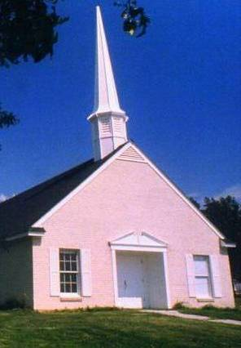
EVERY SDA
CHURCH ...
A center for evangelism through the Publications

