Slide 2
Progression of Programs and Initiatives
Plateau
Growth
Decline
Beginning
End
The Sigmoid curb is used to illustrate how living, social, and organizational entities rise and fall.

Slide 3
Reaching the Unchurched

Slide 4
Ellen White’s Counsel
“Christ's last words to His disciples were lo, I am with you always, even unto the end of the world, go ye therefore, and teach all nations…. To us also the commission is given. And to us also the assurance of Christ's abiding presence is given. --Manuscript 24, 1903.

Slide 5
Ellen White: Review and Herald, July 23, 1895.
“The Church Entrusted With the Message.--We are now living in the closing scenes of this world's history. Let men tremble with the sense of the responsibility of knowing the truth…. A world, perishing in sin, is to be enlightened. The lost pearl is to be found. The lost sheep is to be brought back in safety to the fold. Who will join in the search?”

Slide 6
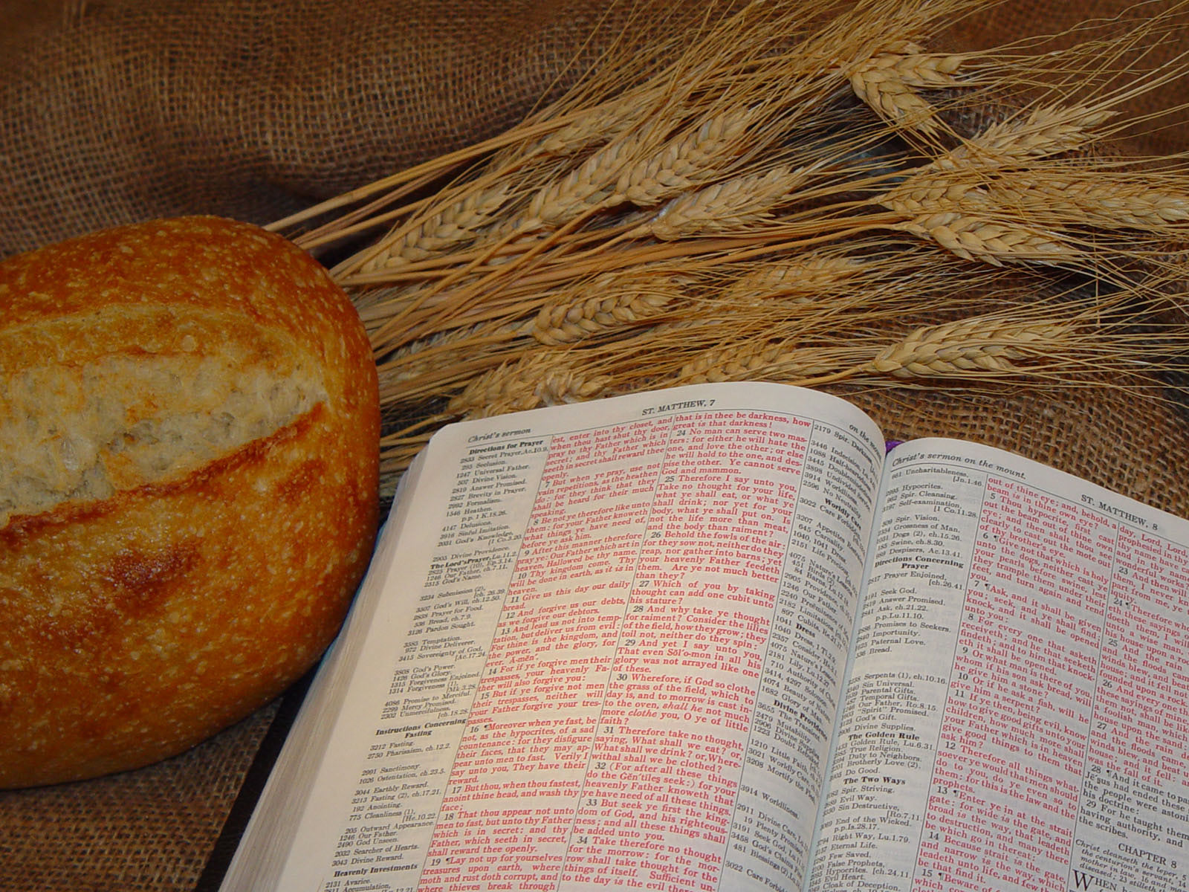
GROWING THE CHURCH

Slide 7
Spirit of Prophecy Quote
“In almost every community there are large numbers who do not attend any religious service. If they are reached by the gospel, it must be carried to their homes. Often the relief of their physical needs is the only avenue by which they can be approached.” Review and Herald, May 9, 1912.

Slide 8
Comprehensive Evangelism:
A combined approach of all departments and entities of the Church to fulfill a the gospel commission.

Slide 9
Comprehensive Evangelism:
“The Lord desires His chosen servants to learn how to unite together in harmonious effort” Evangelism p. 99.

Slide 11
Vision One Million
Commitment
Empowerment
Retention
Comprehensive Evangelism
Involvement
Celebration
Coaching
and Mentoring

Slide 12
Vision One Million
Commitment
Responsible: Pastors, PM/SS Directors, Action Teams, Church coordinators
Comprehensive Evangelism
Call
Recruitment
Ministry Interest

Slide 13
Vision One Million
Empowerment
Training
Equipping
Skills Acquisition
Comprehensive Evangelism
Responsible: Pastors, PM/SS Directors, Action Teams, Departmental leaders

Slide 14
Vision One Million
Deployment
Involvement
Execution
Comprehensive Evangelism
Engagement
Responsible: Pastors, PM/SS Directors, Action Teams, Church Coordinator

Slide 15
Vision One Million
Motivation
Modeling
Maintenance
Responsible: Pastors, Vision One Million Action Teams, Church Coordinator
Comprehensive Evangelism
Coaching and Mentoring

Slide 16
Vision One Million
Special Worship
Visitors Day
Baptisms
Responsible: Pastors, Vision One Million Action Teams, Local Church Vision One Million Coordinator
Comprehensive Evangelism
Engagement
Celebration

Slide 17
Vision One Million
Responsible: Pastors, PM/SS Directors, Retention officers, Small Groups
Retention
Comprehensive Evangelism
Integration
Fellowship
Discipleship

Slide 18
Vision One Million & The Ministries
REL
I
G. L
I
B
E
R
T
Y
WO
M
E
N
FAMI
L
Y
PUB
L
I
SH
I
NG
P
M&S
S
G
L
O
B
A
L
M
I
S
S
I
O
N
STEWARDSHIP
YOUTH
M
I
N
I
S
T
E
R
I
A
L
COMMUN
I
CAT
ION
Comprehensive Evangelism
C
H
I
L
DREN
E
D
U
C
A
T
I
O
N
H
E
A
L
T
H

Slide 19
How to Determine The Vision Number?
For Each Union – 30% of the Membership
For each Local Field – 30% of the Membership
For each Church - 30% of the membership

Slide 20
How to Implement Vision One Million in the District or Church?
Appoint a Vision One Million Action Committee with representatives from each Church or Ministry
Train the team on the details of Vision One Million
Empower the team to Promote the Initiative across the District

Slide 21
How to implement Vision One Million In your district or church:
PREACH….
EXPLAIN….
RECRUIT….
Train the recruited Passionate Disciples
Members of the Vision One Million Action Team may assist in conducting the training
Challenge the Passionate Disciple to work!

Slide 22
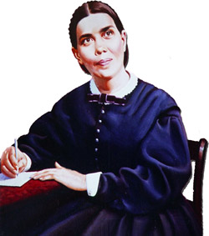
Relationship between Vision One Million and Small Groups
Passionate Disciples may take their baptismal prospects to the small group for group study and fellowship.
Passionate Disciples functioning in Small Groups help to orientate prospects into the faith through the development of strong Social Relationships.

Slide 23
Spirit of Prophecy Foundation
‘’The best help that ministers can give the members of our churches is not sermonizing, but planning work for them. Give each one something to do for others. Help all to see that as receivers of the grace of Christ they are under obligation to work for Him. And let all be taught how to work. Especially should those who are newly come to the faith be educated to become laborers together with God.

Slide 24
Spirit of Prophecy Foundation
If set to work, the despondent will soon forget their despondency; the weak will become strong, the ignorant intelligent, and all will be prepared to present the truth as it is in Jesus. They will find an unfailing helper in Him who has promised to save all that come unto” Him”.--6T 49. {Pastoral Ministry, p. 156.

Slide 25
Comprehensive Evangelism
Global Mission
Communication
Family
Youth
Health
Health Institution
Woman
ADRA
Publication
Education
Stewardship
Children
Religious Liberty
Personal Min.
Ministerial

Slide 26
Comprehensive Evangelism
VISION ONE MILLION
VISION ONE MILLION
VISION ONE MILLION
VISION ONE MILLION
VISION ONE MILLION
VISION ONE MILLION

