Slide 1
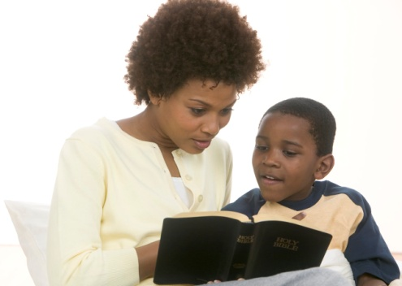
CHILDREN’S MINISTRIES DISCIPLEING IN EVANGELISM

Slide 2
Dynamic Factors in Disciplining Children For Christ
Attraction
Relationship
Responsiveness
Accountability
Empowerment

Slide 3
ALL INCLUSIVE
“The church of Christ on earth was organized for missionary purposes, and the Lord desires to see the entire church devising ways and means whereby high and low, rich and poor, may hear the message of truth.” Christian Service, 72C.

Slide 4
REASONS FOR INVOLVING THE CHILDREN IN EVANGELISM
The Great Commission given by Jesus to His people includes the children.
Children have gifts and abilities , given by God for his purposes, that can be placed in the service of the Master.
Children who share their faith receive great spiritual blessings.
The relation between a child and Jesus can become as intimate as any adult.

Slide 5
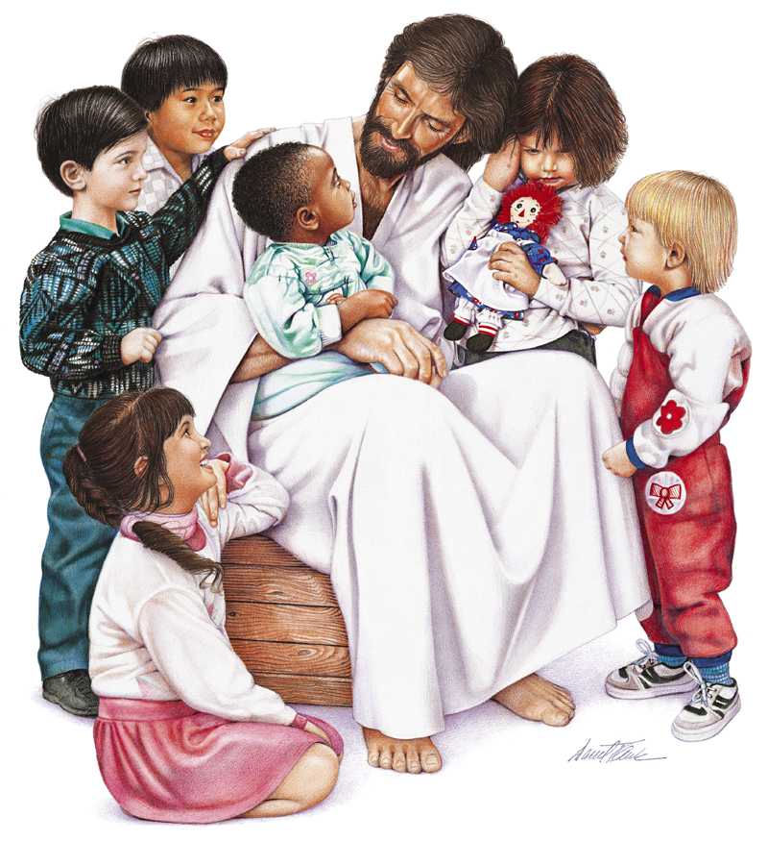
Attraction
Children, feel attracted to Jesus. There are drawn by the sense of love and security that emanates from Him.

Slide 6
RELATIONSHIP
Studying the Bible affirms the child in his faith.
The child preacher, as well as all the children involved in the different ministries of the church, acquires communication and social skills, and intellectual development.

Slide 7
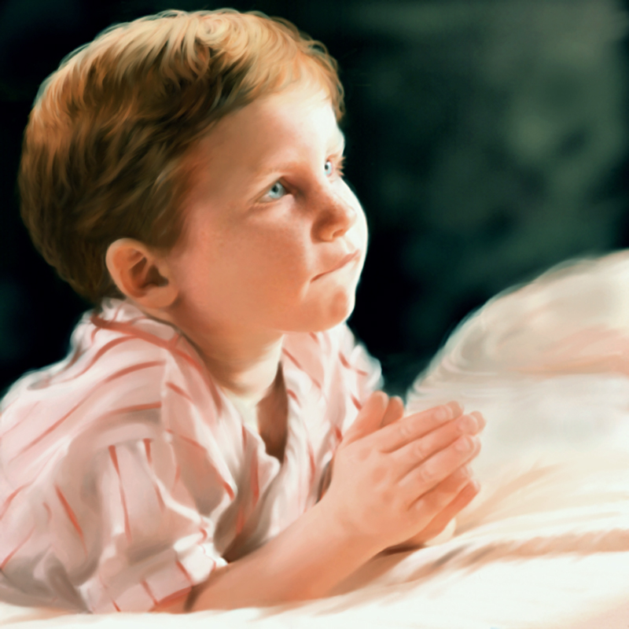
RELATIONSHIP
Children also experiences the joy of seeing souls surrender to Jesus.

Slide 8
RELATIONSHIP
The preaching of the gospel is the center and essence of the Great Commission given by Christ to His church. The disciples after the ascension of Jesus were scattered everywhere telling others what they had seen and heard regarding the risen Savior. Everywhere men listened to the good news of the return of Jesus and many accepted the truth and changed their lives, while others continued in their evil ways.

Slide 9
RESPONSIVENESS
In fulfilling this divine mandate of preaching there is no age, race or cultural distinction. All who accept Jesus as their personal Savior and is born into the kingdom of God as a disciple is called to share the gospel with others. Even children who are moved by the Holy Spirit can speak to others about the return of Jesus with the same fervor and interest as an adult.

Slide 10
RESPONSIVENESS
Nevertheless, in the minds of some people there might be doubt or concern regarding the participation of children in the preaching of the gospel. They think that the business of preaching is the work of adults and that children do not have the spiritual maturity required for such a task.

Slide 11
RESPONSIVENESS
In order to address some of the concerns that have come to the minds of some people as to whether or not a child should be allowed to preach, we wish to share with you the following information, which we hope will help to dispel their concerns.

Slide 12
ACCOUNTABILITY
For many years the church has focused her attention on the children in the framework of the Sabbath school class. This has had as its main objective to contribute to the spiritual growth of the children and to integrate them into the congregational worship as they grow older. Although these classes have encouraged the children to share their faith with others, in reality this was not enough, and perhaps the church’s activities have included very little children participation.

Slide 13
ACCOUNTABILITY
The children of this new millennium are known as the most sociable children , with the most communication skills, therefore we have implemented a missionary strategy where the children who wish may actively participate in preaching. This strategy is known as the Child Disciples Club.

Slide 14
ACCOUNTABILITY
The children who show interest in belonging to this program, do so because they want to be involved in the experience of preaching and serving, something which appeals to them. They have learned to love Jesus and are interested in demonstrating their love in service.

Slide 15
EMPOWERMENT
For that reason, the Children’s Ministries Department have developed a program to instruct and equip children how to better use and share their talents to evangelize the world they live in. The club members identify with the name of child preacher, because they are interested in publicly sharing the message of the Bible and they hope that the people who listen will come to know Jesus.

Slide 16
EMPOWERMENT
It is possible that when the child joins the club or participate in the various ministries of the church, he or she does not fully understand the significance of the transforming power of the Word of God and how men who listen can come to experience a total change in their lives, but a child can feel the joy of telling others how happy it feels to make Jesus their best friend. In other words, we can affirm with confidence that a child preacher is a small proclaimer of the gospel.

Slide 17
EMPOWERMENT
To those who think that a child who has expressed his desire to participate in preaching and in the various ministries within the church needs to show special qualities, is very much mistaken. Child preachers are the same as all the other children, passing through the different stages of physical, intellectual, social and spiritual development, just as any other child his age.

Slide 18
Qualities of a child disciple
These children have the same need to play, jump, shout and laugh as other children who have never stood up in front in a pulpit to preach or to participate in other . They may be happy children, sometimes timid, forgetful, and even distracted, but this does not mean that they are disqualified to be God’s messengers once they are in the hands of the Divine Teacher.

Slide 19
Empowerment and relationship
We know by experience that when a person surrenders to the Lord, all the imperfections of character or weaknesses of his personality begin to be molded and adjusted by God so that he may fulfill the mission that has been entrusted to him. In this very way, when the children place themselves in the hands of God, He imparts to them His blessings and prepares them to fulfill the task, even though they are children with qualities that appear to us to be hardly appropriate for the preaching of the gospel.

Slide 20
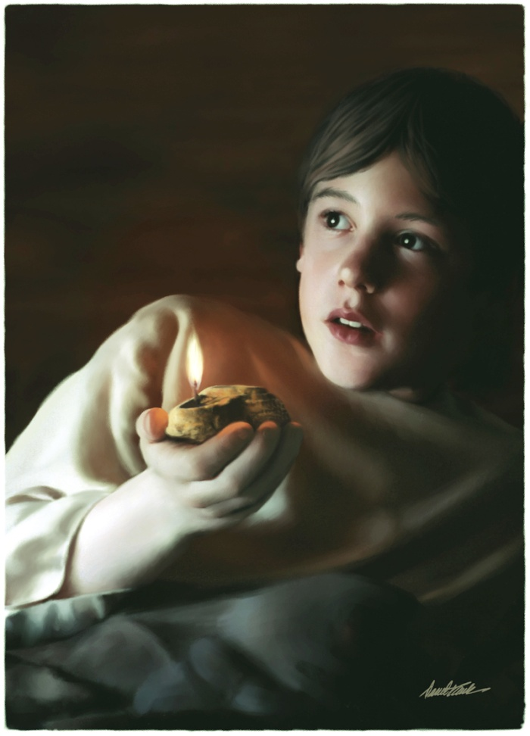
Empowerment and relationship
B. What age should a child be to be able to preach, or to actively participate in the various functions of the ministry of his church?
Samuel was very young when he started serving and later called by God himself.

Slide 21
Empowerment by God – 1 Samuel 3
The Lord Calls Samuel
¹The boy Samuel ministered before the Lord under Eli. In those days the word of the Lord was rare; there were not many visions.
²One night Eli, whose eyes were becoming so weak that he could barely see, was lying down in his usual place.

Slide 22
Empowerment and relationship
³The lamp of God had not yet gone out, and Samuel was lying down in the temple of the Lord, where the ark of God was.⁴Then the Lord called Samuel. Samuel answered, "Here I am."⁵And he ran to Eli and said, "Here I am; you called me."
⁵But Eli said, "I did not call; go back and lie down." So he went and lay down.

Slide 23
Empowerment and relationship
Samuel’s service prompted his call, not the way around.
In a time when God was choosing not to speak to his people because of their wickedness, and no one was interested in listening to God or hear his Word, he chose to call a child.

Slide 24
Empowerment and relationship
God, the Creator, knows the heart of children. He knows what they are capable of doing if we just let them. Their hearts are willingly open to Jesus and his call.

Slide 25
God’s instructions to us
"Let the overseers of the church devise plans whereby young men and women may be trained to put to use their entrusted talents…. Let ministers put to use all their ingenuity in devising plans whereby the young members of the church may be led to cooperate with them in missionary work….Plan ways whereby a live interest may be kindled….Train the young…and bring their reports to the missionary meeting, telling what they have experienced and through the grace of Christ what success has been theirs". (Adventist Home, page 487)

Slide 26
God’s instructions to us
“God wants every child of tender age to be His child, to be adopted into His family. Young though they may be, the youth may be members of the household of faith and have a most precious experience. In their early years children may be useful in God{s work … He will give them His grace and His Holy Spirit" (Adventist Home, page 486)

Slide 27
Therefore, the Children’s Ministries department goal is to fulfill God’s dream for children today
Based on what we just learnt and using the same words from God and the Spirit of Prophecy:
1. Let the ministers and overseers of the church allow and encourage the children’s ministries department in their local church, mission, conference and union, to implement the programs already designed by the Division to train the children of the church to evangelize the world for times like these.

Slide 28
Therefore, the Children’s Ministries department goal is to fulfill God’s dream for children today
2. Let the ministers and overseers of the church allow and encourage the children to put to use their entrusted talents to evangelize the world.
3. Let ministers and oversees of the church put to use all their ingenuity in devising plans whereby the young members of the church may be led to cooperate with them in missionary work to evangelize the world.

Slide 29
Therefore, the Children’s Ministries department goal is to fulfill God’s dream for children today
4. Let the ministers and overseers of the church plan ways whereby a live interest may be kindled in their hearts to evangelize the world.
5. Let the ministers and overseers of the church share and be excited about what children can do, have experienced and through the grace of Christ what success has been theirs in evangelizing the world.

